Slide 1
Day 9th

Slide 2
Objectives
What is JDBC?
JDBC Database drivers
Steps to interact with JDBC
Drivers Installation and connections
Simple Statement
Prepared Statement
Callable Statement
Navigating the Resultset
Initializing the Java object from SQL results
Commit
Rollback

Slide 3



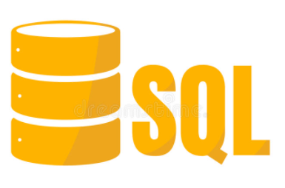
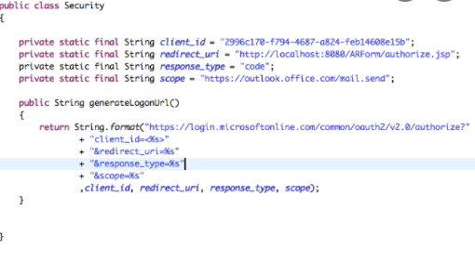
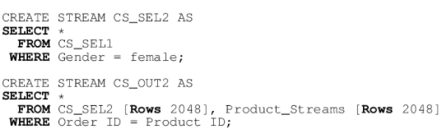

What is JDBC ?
Data

Slide 4
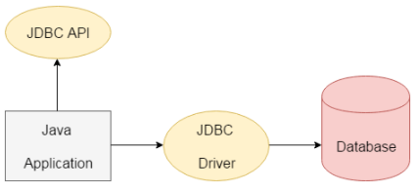
What is JDBC ?
JDBC stands for Java Database Connectivity. JDBC is a Java API to connect and execute the query with the database.
In simple word I can say JDBC is helpful in order connect our java application with database.
We can use JDBC API to access tabular data stored in any relational database. By the help of JDBC API, we can save, update, delete and fetch data from the database.
What id JDBC Driver?

Slide 5
What is JDBC Driver ?
JDBC Driver is a software component that enables java application to interact with the database. There are 4 types of JDBC drivers:
JDBC-ODBC bridge driver
Native-API driver (partially java driver)
Network Protocol driver (fully java driver)
Thin driver (fully java driver)
[Note →ODBC stands for Open Database Connectivity which literally means that it is compatible with all types of languages such as C, C++, Java, etc. JDBC Stands for Java database connectivity i.e only compatible with java language.]

Slide 6
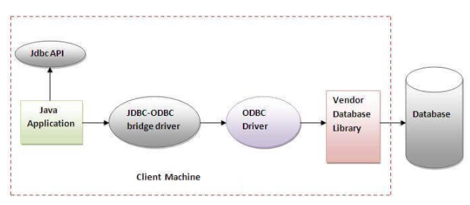
JDBC-ODBC bridge driver
The JDBC-ODBC bridge driver uses ODBC driver to connect to the database. The JDBC-ODBC bridge driver converts JDBC method calls into the ODBC function calls. This is now deprecated because of thin driver.

Slide 7
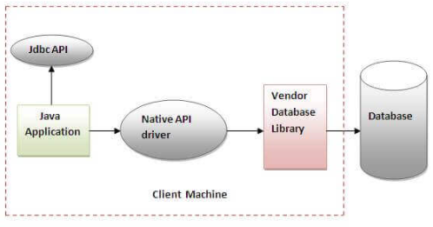
Native-API driver
The Native API driver uses the client-side libraries of the database. The driver converts JDBC method calls into native calls of the database API. It is not written entirely in java.

Slide 8
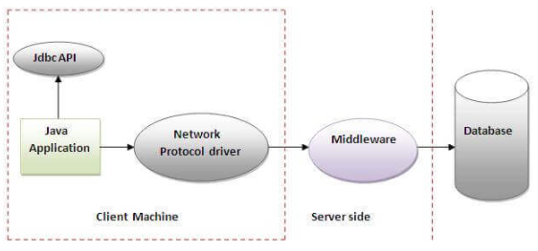
Network Protocol driver
The Network Protocol driver uses middleware (application server) that converts JDBC calls directly or indirectly into the vendor-specific database protocol. It is fully written in java.

Slide 9
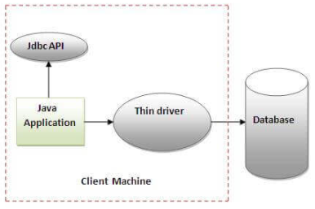
Thin driver
The thin driver converts JDBC calls directly into the vendor-specific database protocol. That is why it is known as thin driver. It is fully written in Java language.

Slide 10
Steps to interact with JDBC
There are 5 steps to connect any java application with the database using JDBC. These steps are as follows:
Register the Driver class
Create connection
Create statement
Execute queries
Close connection

Slide 11
1. Register the Driver class
The forName() method of Class class is used to register the driver class. This method is used to dynamically load the driver class.
Class.forName("com.mysql.cj.jdbc.Driver");

Slide 12
2. Create the connection object
The getConnection() method of DriverManager class is used to establish connection with the database.
Connection con=DriverManager.getConnection
("jdbc:mysql://localhost:3306/joindemo","root","1234");

Slide 13
3. Create the Statement object
The createStatement() method of Connection interface is used to create statement. The object of statement is responsible to execute queries with the database.
Statement stmt=con.createStatement();

Slide 14
4. Execute the query
The executeQuery() method of Statement interface is used to execute queries to the database. This method returns the object of ResultSet that can be used to get all the records of a table.
ResultSet rs=stmt.executeQuery("select * from employees");

Slide 15
5. Close the connection object
By closing connection object statement and ResultSet will be closed automatically. The close() method of Connection interface is used to close the connection.
con.close();
D1

Slide 16
Drivers Installation and connections
In order to connect java application to database using JDBC API , we need thin driver which is also called as Type 4 driver. We can download latest version of it from following url.
https://mvnrepository.com/artifact/mysql/mysql-connector-java/8.0.26

Slide 17
Drivers Installation and connections
In order to establish connection we will have to add in our project using following steps.
Right click on project
Go to build path
Select configure build path
Select library and then simply add jar file by clicking on add jar option.

Slide 18
Simple Statement
The Statement interface provides methods to execute queries with the database. The statement interface is a factory of ResultSet i.e. it provides factory method to get the object of ResultSet.
public ResultSet executeQuery(String sql): is used to execute SELECT query. It returns the object of ResultSet.
2) public int executeUpdate(String sql): is used to execute specified query, it may be create, drop, insert, update, delete etc.

Slide 19
PreparedStatement interface
The PreparedStatement interface is a subinterface of Statement. It is used to execute parameterized query.
Let's see the example of parameterized query:
String sql="insert into emp values(?,?,?)";
As you can see, we are passing parameter (?) for the values. Its value will be set by calling the setter methods of PreparedStatement.

Slide 20
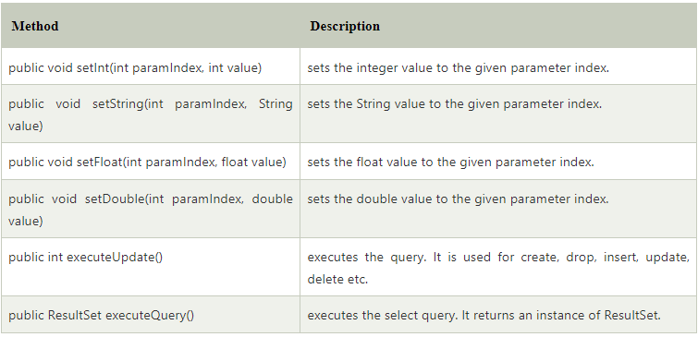
PreparedStatement interface
D2
Methods of PreparedStatement interface

Slide 21
CallableStatement Interface
D3
CallableStatement interface is used to call the stored procedures and functions.
CallableStatement stmt=con.prepareCall("{call empMumab}");

Slide 22
Navigating the Resultset
D4
ResultSet is object in which it fetch data from table .
The object of ResultSet maintains a cursor pointing to a row of a table. Initially, cursor points to before the first row.
Some commonly use methods of ResultSet are
public boolean absolute(int row):
public boolean next():
public boolean previous():
public boolean first():
public boolean last():
public int getInt(int columnIndex):
public int getInt(String columnName):
public String getString(int columnIndex):
public String getString(String columnName):

Slide 23
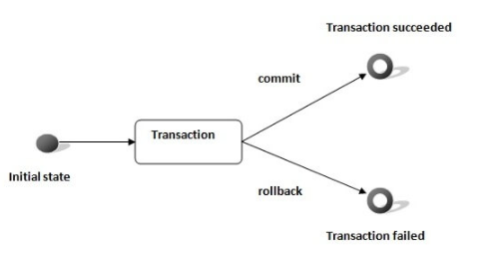
Commit and rollback
D5
Transaction Management in JDBC
There are two methods commonly use for transaction.
1.Commit
2.Rollback
3. con.setAutoCommit(false);

Slide 24
Initializing the Java object from SQL results
D6
See with Demo.

